Slide 1

Information Technology Course Module Computational Intelligence by Prof. Dr. Andreas Pech
Presentation On
Ensemble Learning
Hasibuzzaman
Matriculation Number: 1448140
hasibuzzaman@stud.fra-uas.de
Date: 02.07.2024

Slide 2

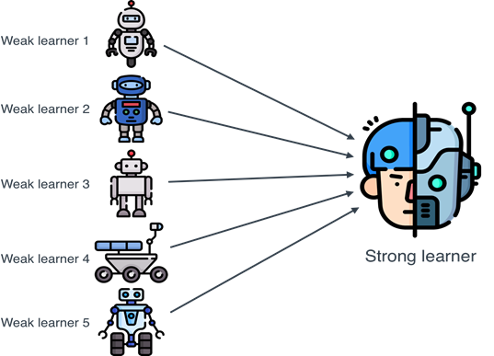
Presentation Topics
In this presentation I will cover these below topics:
Introduction and Objective.
Ensemble Learning Methods
Different Approaches of Ensemble Learning
Self elaborated example using ensemble learning.
Outcome for Malware Detection using ensemble learning model.
Result and Discussion

Slide 3
Introduction and Objective
The goal is to delve into ensemble learning techniques, focusing on Bagging and Boosting and their self-elaborated examples at the end such as malware, anomaly and Intrusion detection system using ensemble learning.
By leveraging Ensemble algorithms and techniques, we aim to choose and compare the model using both bagging and boosting method to enhance decision-making, mitigate risks, and improve overall system(by extracting the system data) reliability and accuracy.

Slide 4
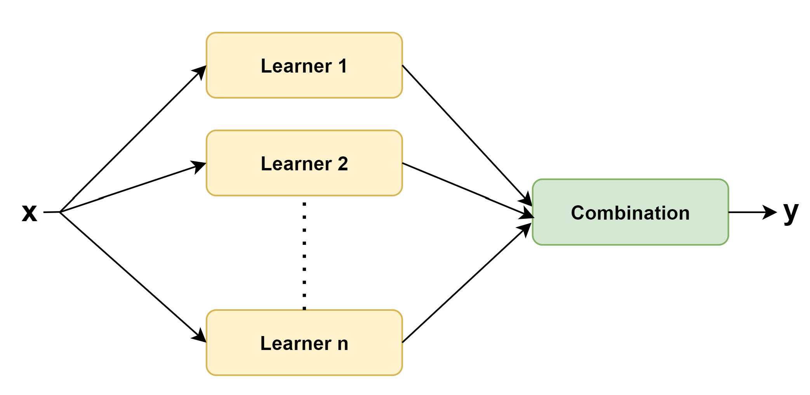
Ensemble Learning Methods
Test Data
Ensemble Model
Training Dataset
Final Prediction
Fig. 1. Simple Ensemble Architecture

Slide 5
Ensemble Learning Methods
Ensemble learning, It is a powerful machine learning approach, combines multiple weak learners [Fig. 1.] to create a strong one, robust model with improved predictive accuracy and stability.
Modify into the sub-dataset from Original Training data called weak learners or base learners or single model.
Combine it into strong learner using the ensemble algorithm like bagging, boosting and stacking.(follow further slides)
Get the final prediction using voting or averaging.

Slide 6
Different Approaches of Ensemble Learning
Weak Learners
A weak learner, or weak classifier, is a model that does just a little better than guessing randomly.
Weak learners are often simple models with high bias(Bias is how well the model fits the training data) & low variance(Variance focuses on how well the model performs on testing ).
Low bias is good for a model to predict better.
High variance means more errors in these checks. So, low variance helps achieve better accuracy.

Slide 7
Different Approaches of Ensemble Learning
Two Parent Types:
Sequential Ensemble Learning
Parallel Ensemble Learning
Sequential Ensemble Learning represents Boosting method
E.g., AdaBoost, XGBoost
Parallel Ensemble Learning indicates Bagging method
E.g., Random Forest, Stacking

Slide 8
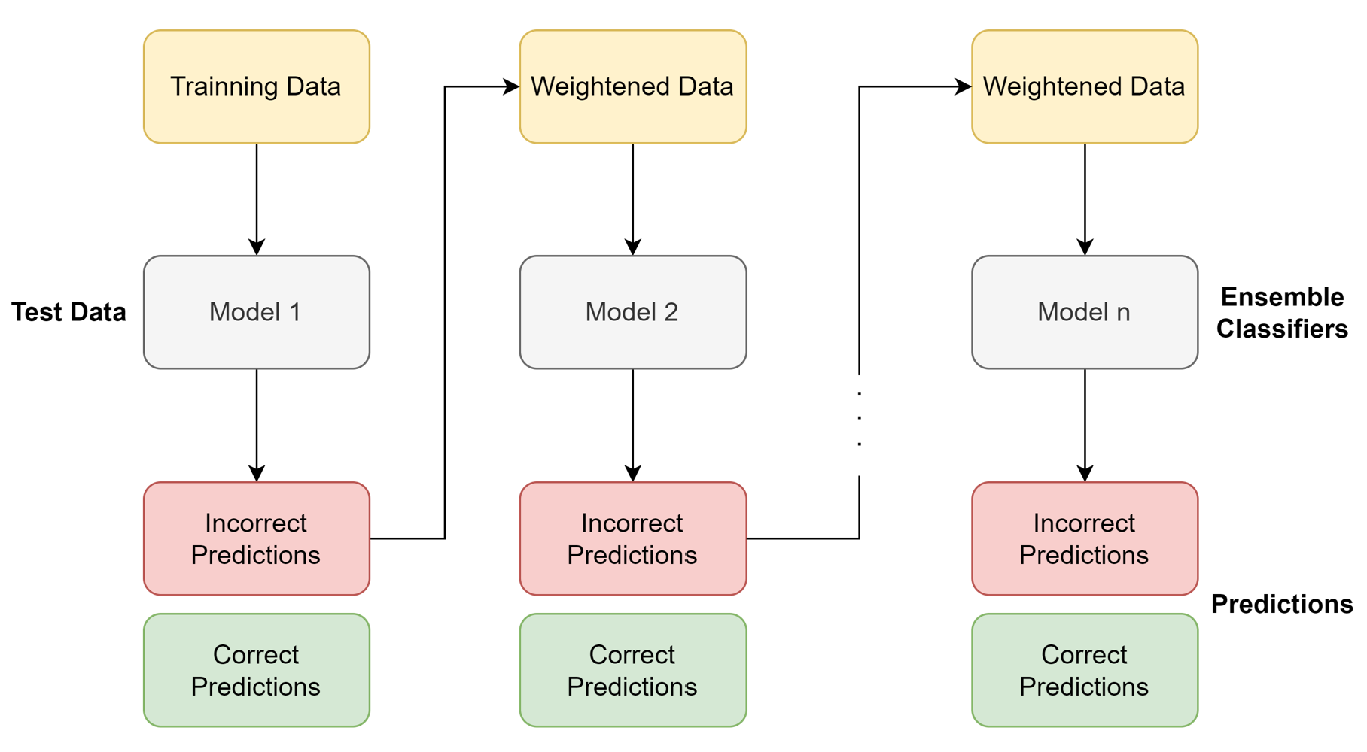
Different Approaches of Ensemble Learning
Boosting or Sequential:
Fig. 2 Boosting Architecture

Slide 9
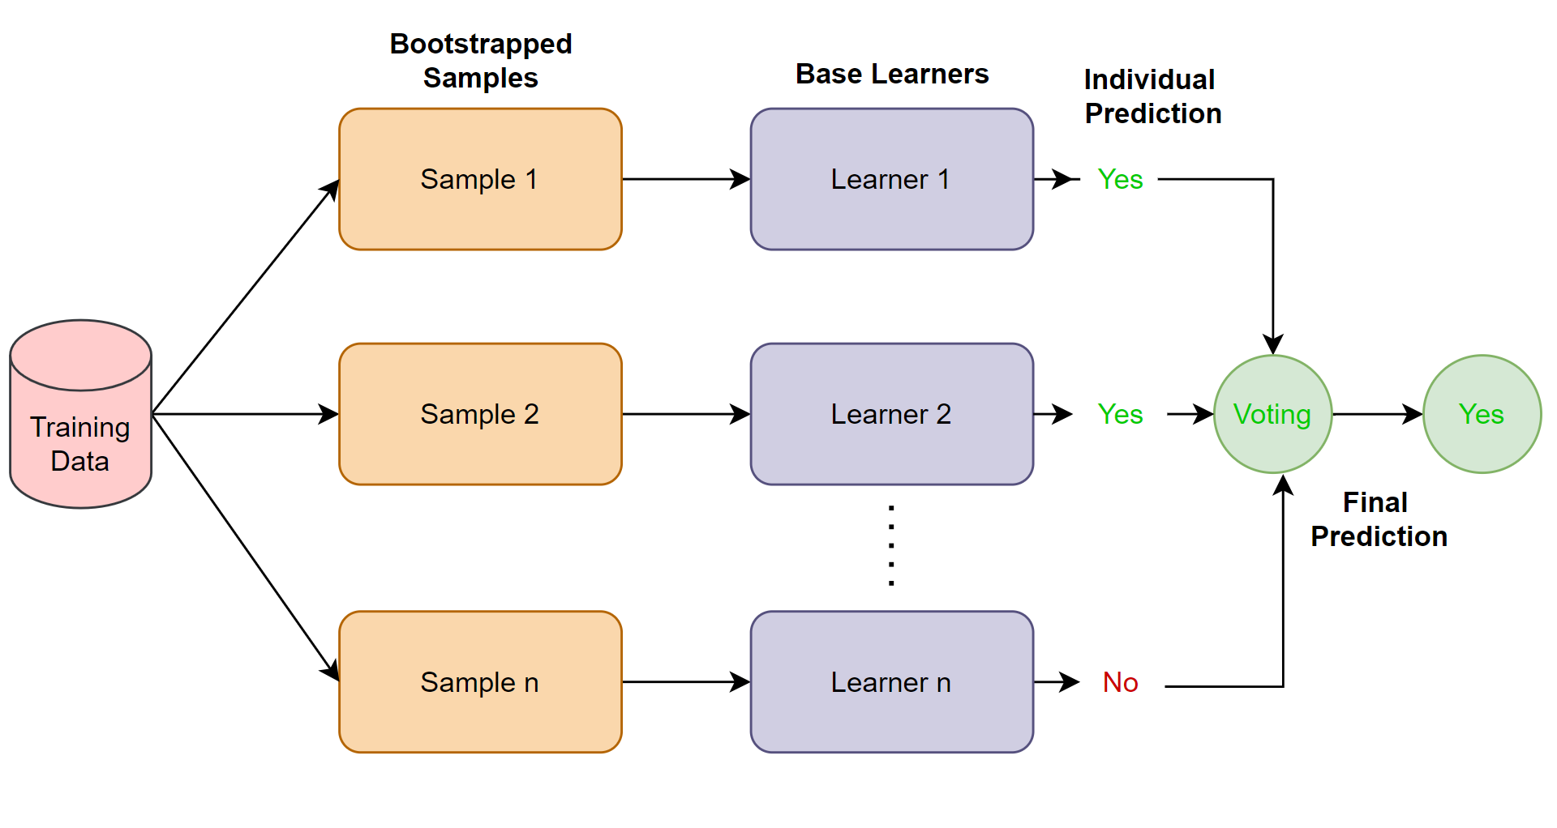
Different Approaches of Ensemble Learning
Bagging or Parallel:
Bagging has two different scenarios that is Homogeneous ensembles ( use same model as base learners or weak learners to make into strong learner like Random Forests) are simpler to implement & tune up. But then we have got heterogeneous ensembles (like Stacking) that use different model at base learners and use meta learner to get final prediction
Fig. 2. Bagging Architecture

Slide 10
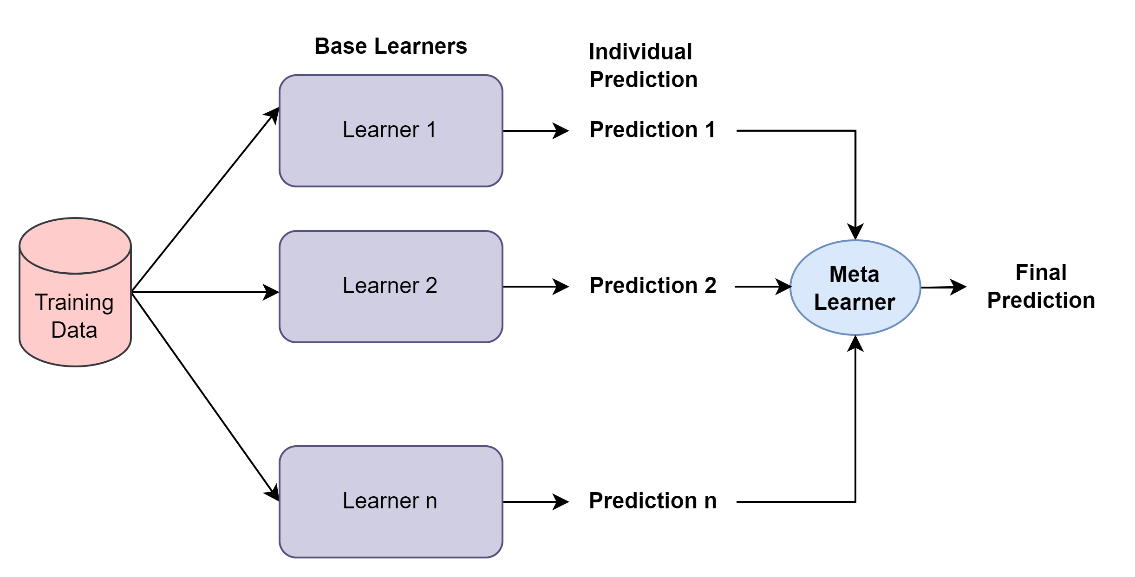
Different Approaches of Ensemble Learning
Stacking:
It is heterogeneous i.e. apply different model/algorithm to train weak learners.
Which take advantage of various algorithms' strengths, leading to better performance and robustness. Using these methods can really boost the predictive powers.
Make prediction from all model by using meta learner.
Fig. 3. Stacking Architecture

Slide 11
Self elaborated example using ensemble learning
Malware Detection in Ensemble Learning
To identify malicious software (malware) within a vast repository of system behavior data.
Implemented Random Forest for Bagging technique and AdaBoost for Boosting technique to compare the result on the same dataset.
Dataset contains 100,000 rows and 35 columns, including the features pertaining to network activity and system metrics, the dataset is taken from a public repository.
Data preprocessing to fit on the model and choose target class to train the model.
Got the outcome (accuracy and classification report). [Fig. 4]
Two more experiments have done intrusion and anomaly detection same way(on result slide).

Slide 12
Outcome for Malware Detection using ensemble learning model
Parameters to Follow:
Overfitting: MSE Train< MSE Test and R2 Train > R2 Test
Underfitting: High MSE and Low R2 values for both.
Good Model: Low MSE and High R2 values with low difference.

Slide 13
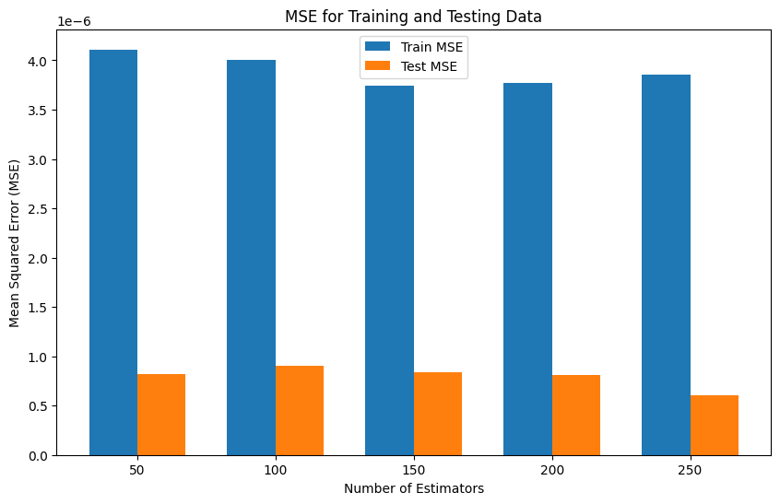
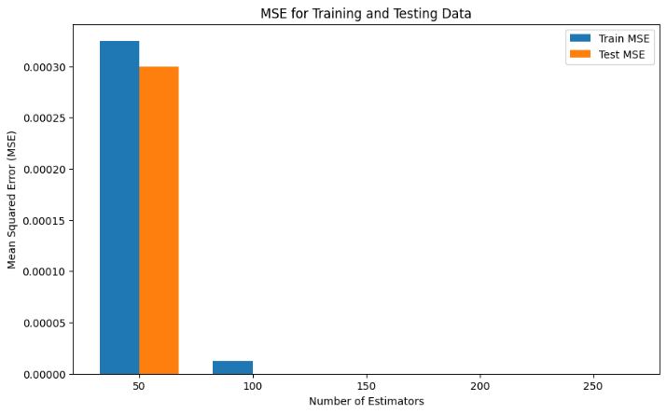
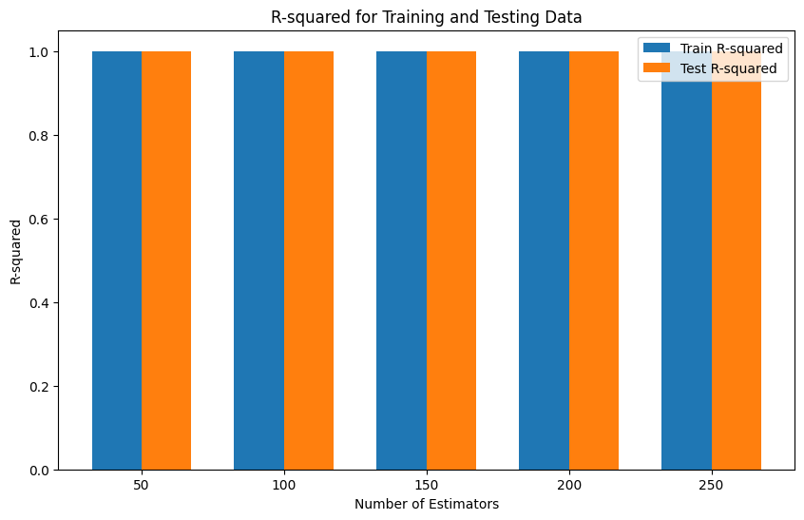
Outcome: Bagging vs Boosting:
Bagging technique Result
Boosting technique Result

Slide 14
Result and Discussion
For Malware Detection, The MSE values of both train and test data are very close to 0, also the R-squared train and test values are high and closed with each other, so both bagging and boosting model generalize well without any overfitting and underfitting. Although the boosting model has better accuracy.
Accuracy Comparison
Applications | Bagging (Random Forest) | Boosting (AdaBoost)
IDS | 98% | 74.32%
Malware Detection | 99% | 100%
Network Anomaly Detection | 98.26% | 62.6%

Slide 15
Q & A

Slide 16
Thank You

